Slide 1







ModelFLOWs
APP
MODAL DECOMPOSITION
DEEP LEARNING
Pattern detection
Reconstruction
Prediction
Pattern detection
Reconstruction
Prediction
HOSVD
Data Repairing
HODMD
Autoencoders
Superresolution
Full DL
HODMD
Superresolution
Hybrid

Slide 2
ModelFLOWs
APP
MODAL DECOMPOSITION
DEEP LEARNING
Pattern detection
Reconstruction
Prediction
Pattern detection
Reconstruction
Prediction
HOSVD
Data Repairing
HODMD
Autoencoders
Superresolution
Autoencoders
Full DL
HODMD
Superresolution
Hybrid

Slide 3
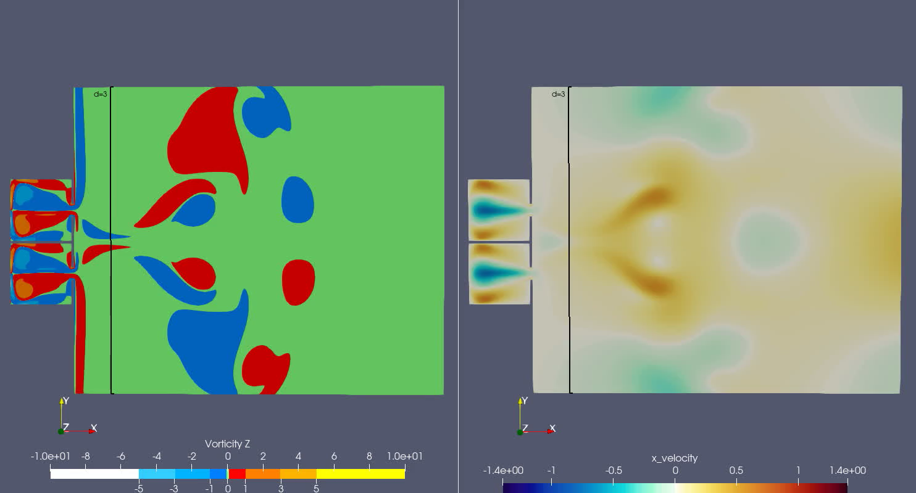
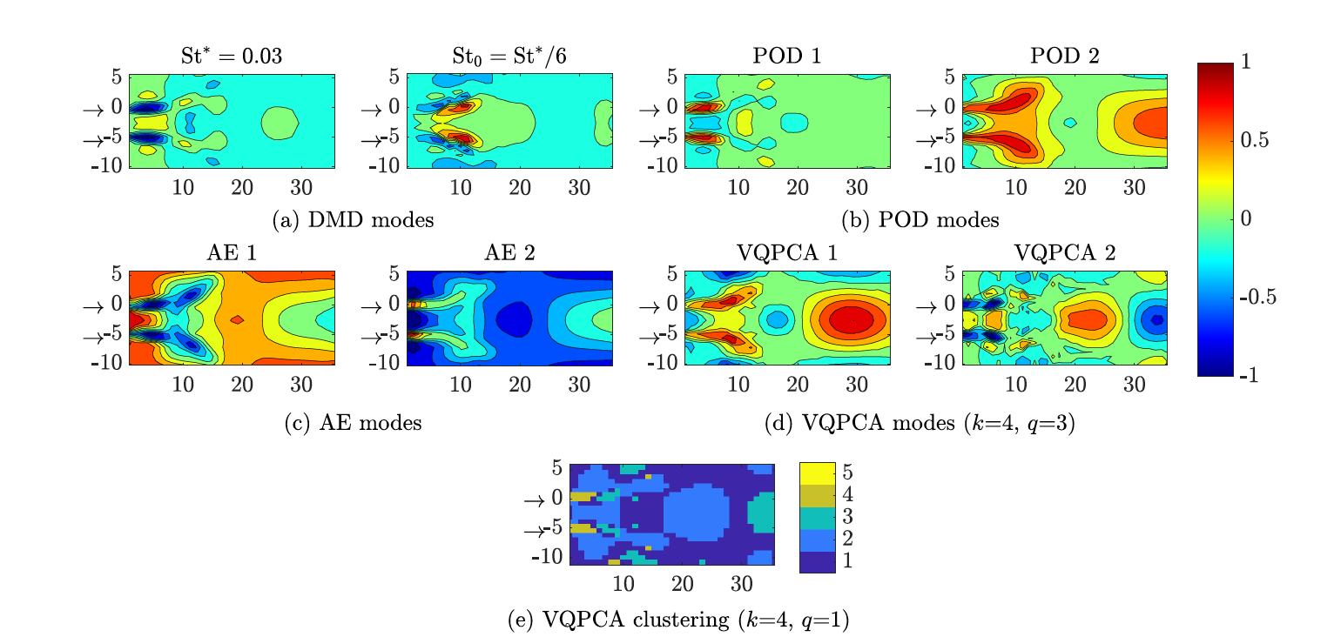
Motivation
Autoencoders
Two planar synthetic jets
Membrane or piston
https://dx.doi.org/10.2139/ssrn.4429450
(Muñoz & Le Clainche, 2022)
Periodical movement:
Injection phase
Suction phase

Slide 4




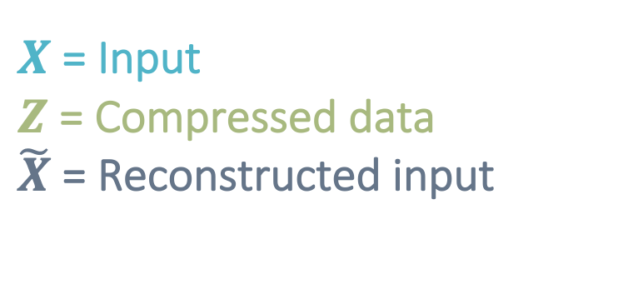

Methodology
Autoencoders
Encoder
Decoder
1
1
Autoencoder is a Deep Neural Network (DNN)
that provides unsupervised feature extraction
2
1
2
3
…
3
$X$ = Input
$Z$ = Compressed data
$\tilde{X}$ = Reconstructed input
4
$$M$$
4
…
$$Z$$
…
p
p
$$\tilde{X}$$
$$X$$

Slide 5
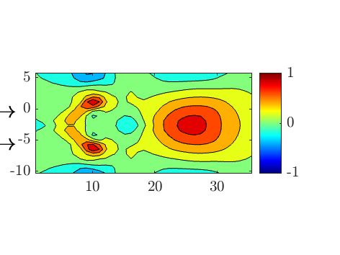
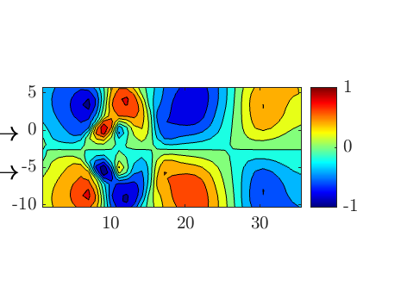
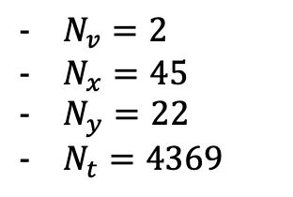

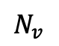
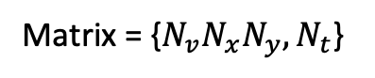
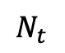
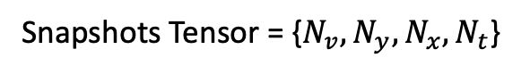
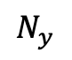
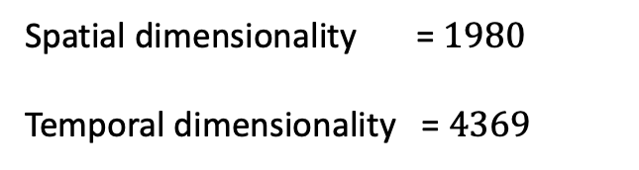
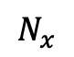
Database & Data preparation
Autoencoders
Spatial dimensions
$$p$$
Snapshots Tensor = {$N_{v}, N_{y}, N_{x}, N_{t}$}
Matrix = {$N_{v}N_{x}N_{y},N_{t}$}
Spatial
Temporal
Variables
Temporal dimensions
Dimensionality
…
$N_{v}=2$
$N_{x}=45$
$N_{y}=22$
$N_{t}=4369$
$$N_{v}$$
Spatial dimensionality = $1980$
Temporal dimensionality = $4369$
$$p$$
$$N_{y}$$
…
$$N_{t}$$
$$N_{x}$$

Slide 6
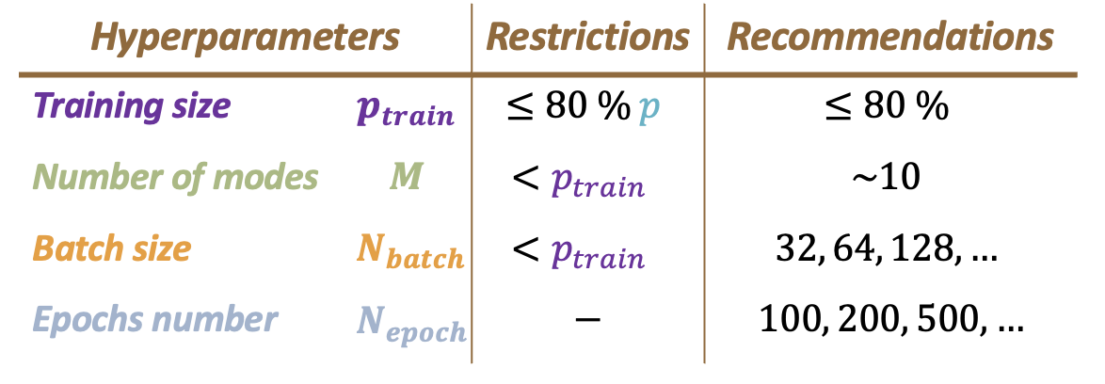
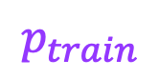
Calibration
Calibration
Autoencoders
Encoder
Decoder
1
1
2
1
2
3
…
3
4
$$M$$
4
…
$$Z$$
…
Batch size
p
p
$$\tilde{X}$$
$$X$$
Epochs
number
…
$$p_{train}$$

Slide 7


Results
Autoencoders
Click here for more information
Also compared with local PCA clustering technique (VQPCA)

Slide 8

Thanks for watching! Visit us on: https://modelflows.github.io/modelflowsapp/

Slide 9

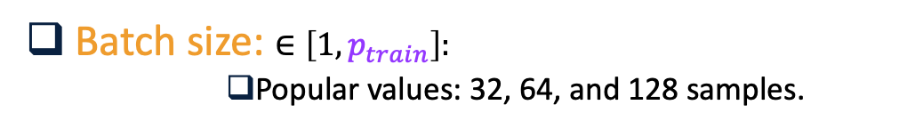



Calibration
Calibration
Autoencoders
Encoder
Decoder
Hyperparameters:
1
Test, training size: $p_{train}≤80\% p$
Popular values: 70%, 80% …
1
2
1
2
Encoding dimension: $N<p_{train}$
3
…
3
Batch size: $∈\left[1,p_{train}\right]:$
Popular values: 32, 64, and 128 samples.
4
$$N$$
4
Epochs number
Popular values: 100, 200, 500, ...
…
$$Z$$
…
Batch size
p
p
$$\tilde{X}$$
$$X$$
Epochs
number
…
$$p_{train}$$

Slide 10
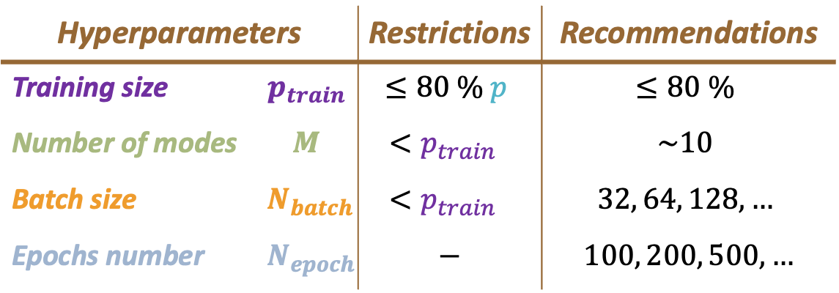
Hyperparameters |  | Restrictions | Recommendations
Training size | $$p_{train}$$ | $$≤80 \% p$$ | $$≤80 \%$$
Number of modes | $$M$$ | $$<p_{train}$$ | $$\sim 10$$
Batch size | $$N_{batch}$$ | $$<p_{train}$$ | $$32, 64, 128, …$$
Epochs number | $$N_{epoch}$$ | $$−$$ | $$100, 200, 500,…$$
Table:
Figure:

